Slide 1



Slide 2



 | Slope Bins 4 | Smear Count 25
Block number | Alpha w/ Henderson Hasselbalch | Chi Chi_max = 2.2
[0 50] | 0.040012 | 1.160000
[50 75] | -0.278451 | 0.720000
[75 125] | -0.519707 | 0.608000
[125 156] | -0.154453 | 0.529032

Slide 3


 | Slope Bins 4 | Smear Count 31
Block number | Alpha w/ Henderson Hasselbalch | Chi Chi_max = 2.2
[0 31] | 0.001103 | 0.922581
[31 62] | -0.386873 | 0.703226
[62 93] | -0.290146 | 0.967742
[93 496] | 0.037164 | 1.098759
[496 527] | -0.064533 | 0.819355
[527 620] | 0.010682 | 0.756989
[620 647] | -0.103326 | 0.696296

Slide 4
Binary results

Slide 5
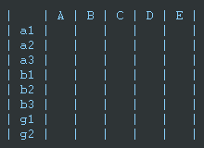
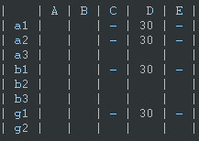
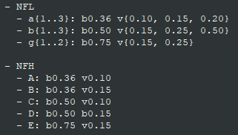

Matrix Approach
Updated 04/04/2023

Slide 6







For i as L and H:
Pure height profiles
Mixed height profiles
Current L library
Current H library
Skip; marginal increase in vol prob not enough
Move onto chi3.0; larger NFL vol library

Slide 7





NFL
All plotting wrong L pure; look only at purp
NFH
H volume too low to neutralize L (v = 31 nm3/c)

Slide 8







H volume v = 60 nm3/c

Slide 9







H volume too low to neutralize L

Slide 10








NFH, V = 70

Slide 11





NFH & NFL v = 0.15
a2D
b1D
g1D

Slide 12





Based on NFH b5v15c3, apply VL = VH
NFL and NFH are from same amino acids but diff chain lengths. Should VL = VH?
L30 / H70
L80 / H20
L30 / H70
L80 / H20

Slide 13




L30 / H70
L80 / H20
L30 / H70
L80 / H20

Slide 14
L Fitting

Slide 15


VL = VH

Slide 16







Try b change, v same as H (0.15)
Phi unrealistic (?)
Phi unrealistic
Phi very unrealistic
Phi very unrealistic

Slide 17






Try similar params to H
5.6
11.2
16.8
28
56
7.5
11.25
18.75

Slide 18







Try similar params to H, b0.36
7.8
15.6
23.4
31.2
Unrealistic vol
Not very sensitive to v; not high enough to intersect neighboring chains (function of b and sigma)

Slide 19


Continuation from prev params

Slide 20







v2.7 and some fine
b1.50 v2.7 c3.2
b1.75 v2.7 c3.2
b1.75 v2.5 c3.2
b1.75 v2.5 c3.0
b2.0 v2.7 c3.2
b2.25 v2.7 c3.2
b2.50 v2.7 c3.2
Phi too small to decrease v0

Slide 21










b2.0 v10.0 c3.0
b2.0 v8.0 c3.0
b2.0 v6.0 c3.0
b2.0 v4.0 c3.0
b2.0 v2.0 c3.0
Phi limit
b1.8 v10.0 c3.0
b1.8 v8.0 c3.0
b1.8 v6.0 c3.0
b1.8 v3.0 c3.0
b1.8 v2.0 c3.0
Phi limit

Slide 22





b1.6 v10.0 c3.0
b1.6 v8.0 c3.0
b1.6 v6.0 c3.0
b1.6 v2.0 c3.0
b1.6 v1.5 c3.0
Phi limit

Slide 23


Response to stimuli given composition
Same data
Effect of composition given environment

Slide 24


NFL, pH 7.44, phos 1.5e (locs from LCMS)
Non-phos NFL
Block number | Alpha w/ Henderson Hasselbalch | Chi Chi_max = 3.2
[0 50] | 0.040012 | 1.540000
[50 75] | -0.278451 | 0.960000
[75 125] | -0.519707 | 0.868000
[125 156] | -0.154453 | 0.690323
 | Slope Bins 4 | Smear Count 25
Block number | Alpha w/ Henderson Hasselbalch | Chi Chi_max = 3.2
[0 50] | -0.019988 | 1.540000
[50 75] | -0.278451 | 0.960000
[75 125] | -0.519707 | 0.868000
[125 156] | -0.154453 | 0.690323

Slide 25


NFH, pH 7.44, phos 1.5e (locs from LCMS)
 | Slope Bins 4 | Smear Count 36
Block number | Alpha w/ Henderson Hasselbalch | Chi Chi_max = 3.2 | Chi Chi_max = 3.0
[0 36] | 0.000945 | 1.266667 | 1.20000
[36 72] | -0.527455 | 0.900000 | 0.85000
[72 324] | -0.208376 | 1.729365 | 1.628571
[324 396] | -0.111195 | 1.416667 | 1.333333
[396 432] | -0.152824 | 1.344444 | 1.266667
[432 647] | -0.033955 | 1.077209 | 1.015814

Slide 26

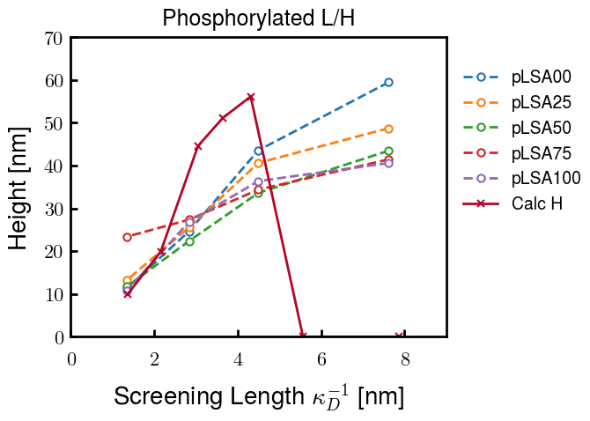
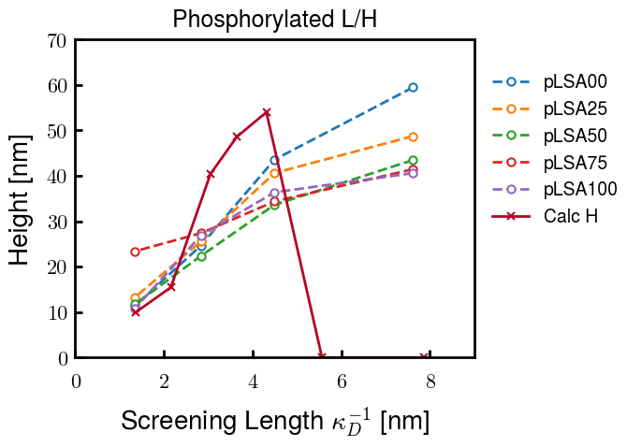
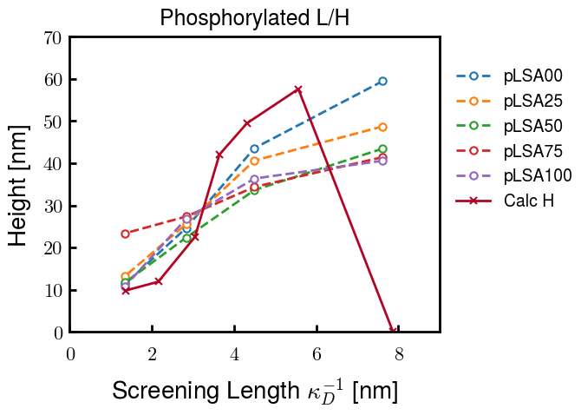
Instead of fitting b/v, could just change value of charge on phos. Try both and see if makes difference for mixture

Slide 27









b2.0 v2.7 c3.2
b3.0 v3.5 c3.5
b3.0 v7.0 c3.5
b3.0 v7.0 c3.0
Phi too small
Phi too small to decrease v0
b4.0 v12.0 c3.0
b5.0 v20.0 c3.0
b5.0 v20.0 c4.0
b5.0 v5.0 c3.0
b5.0 v10.0 c3.0
Phi too small to decrease v0

Slide 28





v20
b5.0 v20.0 c3.0
b4.5 v20.0 c3.0
b4.0 v20.0 c3.0
b3.5 v20.0 c3.0
v10
b5.0 v10.0 c3.0
b4.0 v10.0 c3.0
b3.0 v10.0 c3.0
b2.0 v10.0 c3.0

Slide 29




b2.00 v2.70 c3.20
b2.00 v2.75 c3.20

Slide 30
NFH fitting (from NFL best fit)

Slide 31








b1.00, v0.50, c3.2
b2.00, v4.00, c3.2, th2.5e-02
b1.00, v2.00, c3.2
b1.00, v1.00, c3.2

Slide 32
Mixture

Slide 33



Slide 34


b = 0.75

Slide 35





Slide 36
b = 1.0

Slide 37





Slide 38
b = 1.25

Slide 39




Chi 2.6
Bad vol frac

Slide 40








b25v0
b25v1
b25v2
b25v3

Slide 41




Chi 2.8
Bad vol frac

Slide 42





Slide 43
b = 1.50

Slide 44






Chi 2.8
Bad vol frac

Slide 45





Slide 46

b = 2.00
v4 = 0.25*b^3

Slide 47


Bad vol frac

Slide 48



Slide 49
Fine tune

Slide 50



b1.25, v1.95, c3.0
b1.50, v3.38, c3.0
b2.00, v4.00, c3.0
Norm seems to capture kinked behavior

Slide 51




Slide 52



b1.25, v1.95, c3.2
b1.50, v3.38, c3.2
b2.00, v4.00, c3.2

Slide 53




Slide 54


b1.25
b1.50
b2.00
c2.8
c3.0
c3.2

